Slide 1
Final Project
Search (ILS - Z534)
By:
Pgujarat - Pranav Gujarathi
Nakopa -Naga Anjaneyulu
Yashjain - Yashvardhan Jain

Slide 2
Exploring the Dataset
Yelp Dataset
User.json 1,637,138 Unique Users
Business.json 192,609 unique businesses
Tip.json 1,223,094 Tips
Review.json 6,685,900 reviews
Checkin.json 161,950 checkins
Photo.json

Slide 3
Analyzing and Filtering data
From all the businesses , we have sampled business which offer pizza , italian cuisine on their menu .
We were able to sample around 6k such businesses and based on user profiles and their corresponding reviews for those businesses ,we were able to obtain approximately 600k reviews.
From these reviews, we further sampled users who have written more than 5 reviews ,this resulted in 160k reviews.
If a user has reviewed the same business more than once,we are considering the most recent review only. So, we were left with 159k reviews .

Slide 4
Data Preprocessing and cleanup
After initial data creation, we look at the raw data to observe the important features that can be used for predicting the star rating.
All the review related features like text, sentiment,etc which occur at the same time as the star rating are not used for prediction directly. However, for a particular user, if all reviews are arranged in chronological order then aggregation of all these features before that certain review can be used. For example, if a user writes 5 reviews, then for the chronologically 3rd review he writes, the total text and average sentiment associated with the first two reviews can be used as a feature to predict the star rating. We shall refer to these aggregated features as legacy features.
This leaves us with time independent business attributes,user attributes,etc which can be used after appropriate data preprocessing(removing missing values, non variant features, one hot encoding,etc) . This way, we still have some features to predict in case of cold start.

Slide 5
Processing Text data
As discussed in previous slide, to predict star rating of a visit we use all of text submitted in the previous reviews of the user i.e. legacy text. We can utilize legacy text of the business as well, however that task was computationally out of scope for us.
We apply commonly available text cleaning techniques like removal of non-alphanumeric terms, converting all terms to lower case, removing stopwords, etc.
We feed the tokenized terms to a Tf-Idf vectorizer to get scores associated with each term, however we only consider terms with document frequency above a certain threshold. We now have terms and their tf-idf scores as features available for each star rating prediction.

Slide 6
Problem Statement
Task 1: Recommending businesses to users
Based on the reviews and user profile , we would like to predict how a user would rate a business which he/she hasn’t visited before.
Based on these star ratings for businesses, we would recommend restaurants to this user in decreasing order of predicted rating i.e star rating
Assumption: Star rating is a complete indicator of the user’s preference for a business.

Slide 7
Task 1
Model - 1: We have built a memory based collaborative filtering model. This model uses the user ID, business ID and associated star rating for creating embedding which maps users to businesses. This embedding is used for finding similarities between users,businesses .It uses SVD to condense this sparse [user*business] matrix, and calculate the missing values and return to us the likely ratings for a business by a user.
Model - 2: We are using memory based model to create a dense latent vector associated with each user and each business. We combine these latent vectors with the text features(tf-idf vectors) and then use a neural network based CF approach to predict ratings.

Slide 8
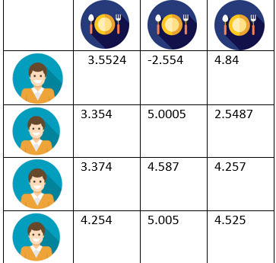
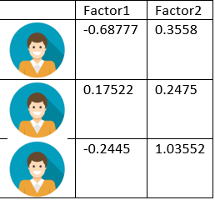
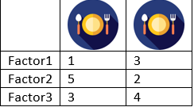
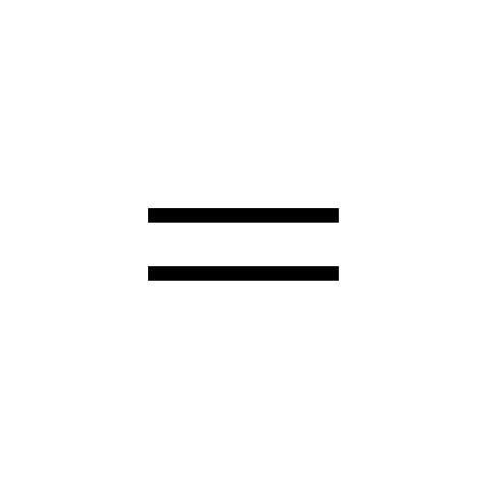

Model-1 Design
Model prediction of the rating = dot product of the embeddings vector + user bias + item bias.
F1 score | MSE
0.1342567 | 1.961109
Notes:
The way we approach the collaborative filtering problem is we assign a set of weights to each user and a set of weights to each business and the dot product of these things will be the rating by the user for that business.These embeddings will represent features like user taste,preferences.An embedding is a mapping from discrete objects, such as ids of business,wordsof reviews and users in our case, to a vector of continuous values. This can be used to find similarities between the discrete objects, that wouldn’t be apparent to the model if it didn’t use embedding layers. So, we have performed Single value decomposition(SVD) on this data.

Slide 9
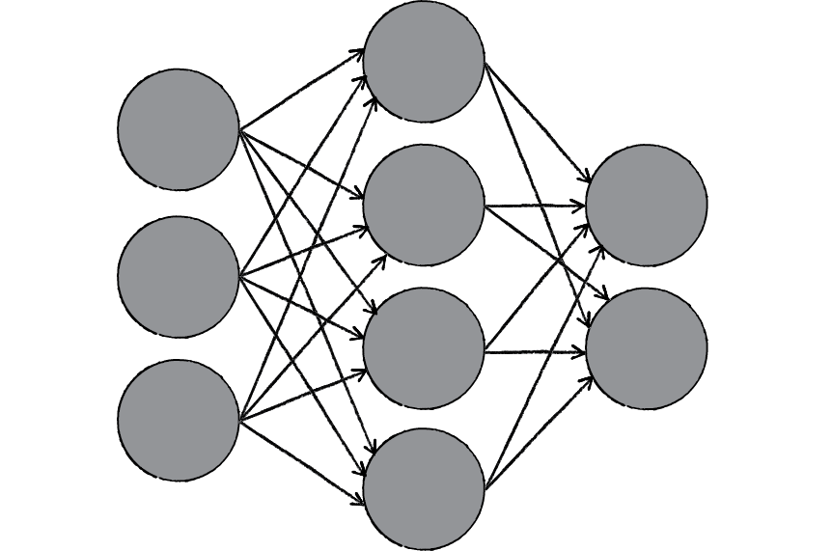
Model-2 Design
USER
I NPUT
VECTOR
B I Z
FEAT
Notes:
We create separate embeddings for the user ,say of fixed dimensions,capturing the latent features for each user from his/her legacy features such as funny,cool,useful reviews votes etc,similarly we also have embeddings for a business which captures latent features for each business based on various attributes like ambience,delivery options,amenities etc .and we also also use other features such which includes textual data reviews given by user and combine these embeddings and feed into a neural network and predict the ratings for a business by a user.

Slide 10
Potential Improvements
We are considering the user’s legacy features , business’s attributes and other features which are specific to a business and a user .
Features also include user reviews .
Evaluation and Results :
F1 score | MSE
0.32 | 1.21

Slide 11

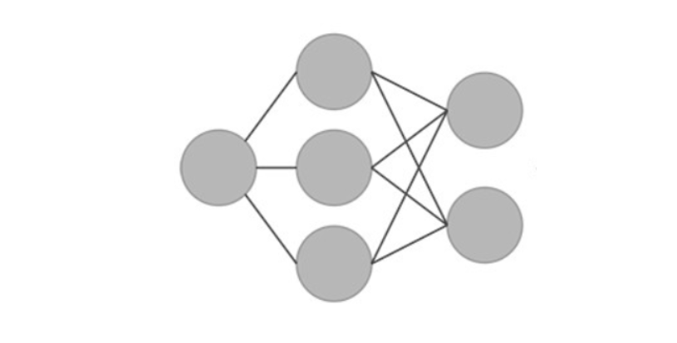
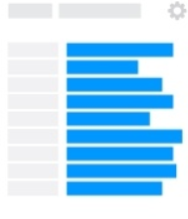
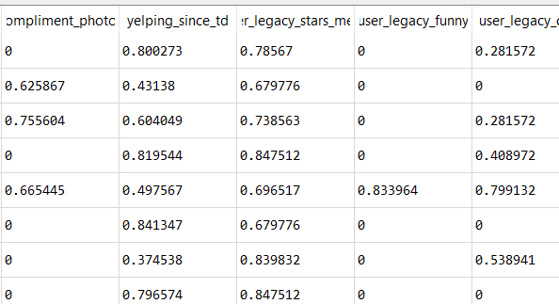
Problem Statement
Task 2: Driving factors for a business
We would like to offer a service to the business owners which help them understand the quantitative impact of different factors which drive the star ratings for their businesses.
This service is built upon the model used in previous task for recommending business to user.

Slide 12
Importance Of Proposed Question
Instead of focussing on the users, we want to focus on the businesses.
We want to use the user activity data to better serve businesses.
Suggest what attributes businesses should be focussing on in order to better serve the users, and make their businesses better and more profitable.
Businesses can then improve based on these results.
We will use model agnostic algorithms, ie, the algorithms just depend on the input feature values and predictions, and are independent of whatsoever model we use
Better Businesses
Better Experience for Users

Slide 13
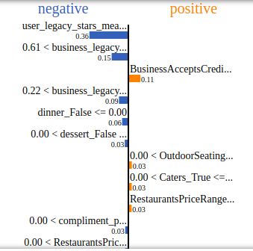
Proposed Solution
We use two popularly implemented algorithms for this task, LIME and Shapely
Both give us, on a data point level, what impact each feature has on the prediction.
Business owners can then take average impacts of users they want to focus on, and then plan their strategy accordingly, since business attributes also have a high impact on star ratings

Slide 14
Task 1: Conclusion and Future Scope
Memory based CF is too simple and gives low performance, and is only driven by the users previous ratings and not business attributes. It is also prone to cold start
Where as our Embedded NN model ,which improves upon the memory based CF, considers a whole of lot of other features which are related to user,business. However this model suffered from high computations requirement which might not be worth the cost given the revenue addition due to increased performance.
The NN model can also be improved upon by further hyper parameter tuning of the neural network
As an addition to Embedded NN model, the text related data can be used more extensively using word embeddings and a sequential model.

Slide 15
Task 2: Conclusion and future scope
LIME uses only linear models to approximate local behaviour , so it might not capture complex feature interactions, not to mention being computationally expensive.
An improvement over this is Shapely, which works by alternatively masking certain features in prediction which have lower impact weights, and then updates the weights based if the prediction performance reduced or not.
If an dependent variable like revenue addition is known, we can model this as our target variable instead and build an optimization pipeline which returns to the business owner adjustments to certain features of his business so as to maximize revenue.

